Slide 1
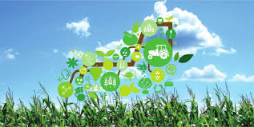
KNOWLEDGE INSTITUTE OF TECHNOLOGY
S.ABARNA
II-CSE:B

Slide 2
IOT IN AGRICULTURE
Smart farming is a concept quickly catching on in theagricultural business. ... IoT sensors capable of providing farmers with information about crop yields, rainfall, pest infestation, and soil nutrition are invaluable to production and offer precise data which can be used to improve farming techniques over time.

Slide 3
How IoT Is Digitizing India?
Large farmers are now deploying ‘Precision Farming’ techniques that use field sensors to monitor farming operation
Agri-Robotics are also picking up well in developing countries to basic farming activities like tilling, ploughing etc.
Ex: In brazil,farmers expected to use unmanned tools such as drones to collect and analyze real time crop_intelligence

Slide 4
Smart And Open Sources In IoT
The OpenAG Initiative at MIT Media Lab uses "personal food computers“ and an open source platform to collect and share data.
The collected data is termed a "climate recipe“,which can be used to reproduce the climate variables.
This allows users very precise to control the documents removes the element of poor weather conditions and human error.

Slide 5
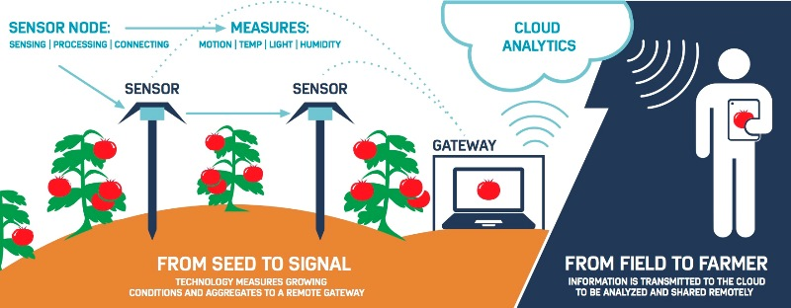
Smart Sensors IoT Red And Ripe
At the heart of the Internet of Tomatoes Project is a sensor-based system to measure the quality of the popular red produce. Source: ADI.

Slide 6
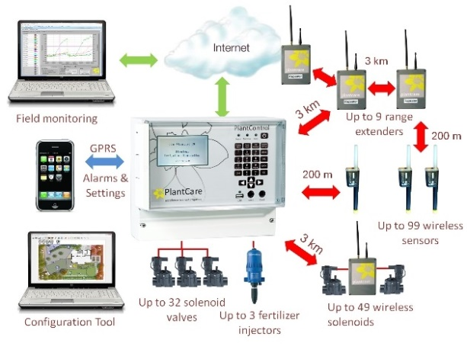
Smart Sensors De-stressing Plants
PlantCare AG’s system aims to control the growth environment moisture, chemistry/fertilizer, and other factorss so that produce undergoes less environmental stress from seeding to harvest. Source: PlantCare AG.

Slide 7
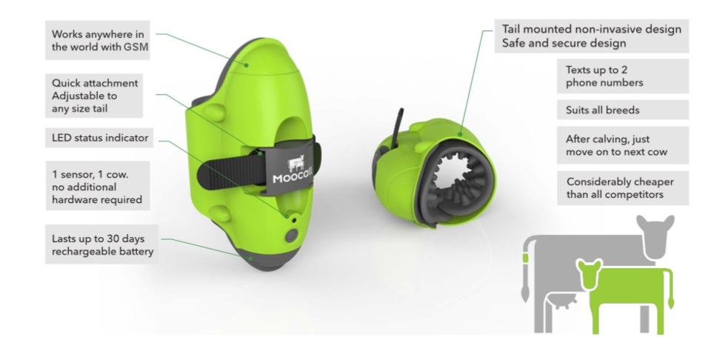
Smart Sensor Herd Maternity
Designed to be mounted on a cow’s tail, the Moocall sensor gathers and transmits data about tail movements, which indicates when a cow is going into labor.Source: Moocall.

Slide 8
IoT related projects on Agriculture
Weather Monitoring
Greenhouse / Agriculture warehouse / Cold-chain monitoring
Farm monitoring / livestock
Milk Farm monitoring
Home gardening
GPS based navigation for Tractors in order to cover most of the filed in a timed and efficient manner.

Slide 9
Applications
It is forecasted that by the year 2050, the Agricultural Internet of Things will increase food production by 70% and be feeding up to 9.6 billion people.
Crop water and pest management
Precision agriculture
Livestock
Food production and safety,etc,..

Slide 10
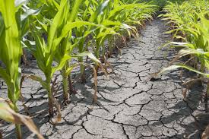
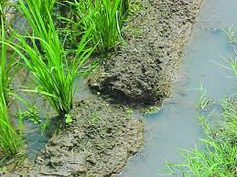
CROP WATER MANAGEMENT
Usually the farmer pumps the water more or less to cultivate the land.
This may result in wastage of water or insufficiency to the crops.
sends an alerting message to the farmer when the moisture level increases or decreases.

Slide 11
Pest Management
Often farmers hardwork are destroyed by
predators(pests) that results in huge loss to farmers.
To prevent such situation AGRICULTURE INTERNET
OF THINGS has a system that detects the motion
of predators using PIR sensors.
This information can be used by the farmers to reduce
damage done by predators.

Slide 12
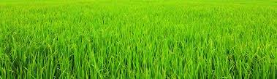
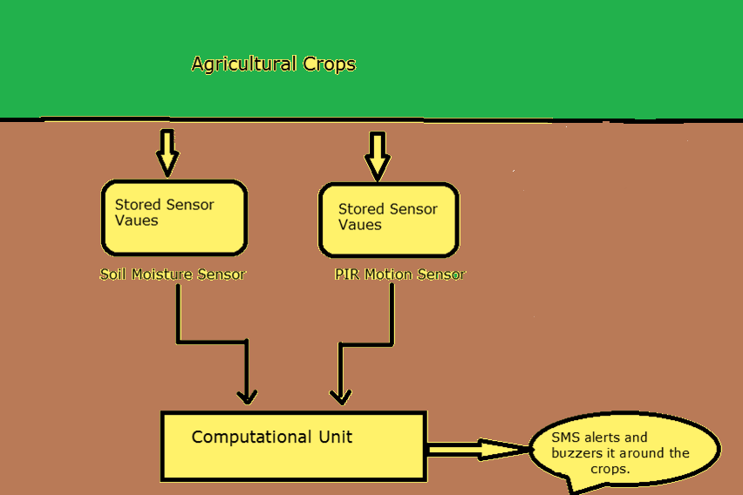
Implementation method

Slide 13
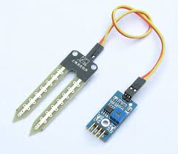
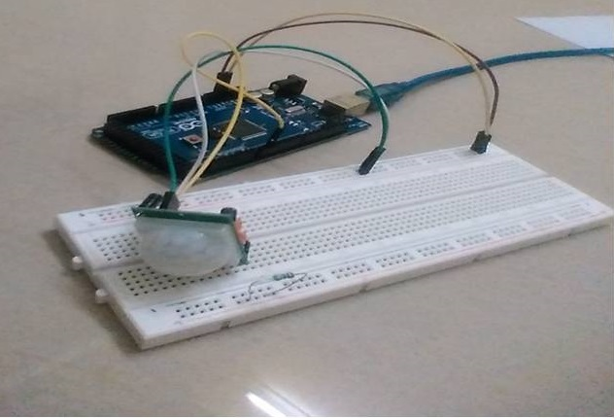
Soil Moisture And Pir Sensor
A sensor that will sense
the moisture level in the
land (sand) called SOIL
MOISTURE SENSOR.
A PIR based motion
detector is used to sense
movement of people,
animals or other objects.

Slide 14
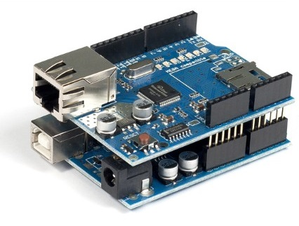
Arduino
Both SOIL MOISTURE SENSOR and PIR SENSOR are connected to the Arduino to perform an action.
Arduino will send the data
to the data base using
Ethernet shield and if
emergency it also send message to the user by using a device called GSM module

Slide 15
New Application
The Phenonet Project by Open IoT
This helps to improve quality and helps the plant breeders to monitor and promote plant growth under various climate conditions.
The Phenonet Project is a step ahead in the Agricultural IoT, driving improved quality by measuring on field environmental and plant physiology parameters resulting in improved quality.

Slide 16
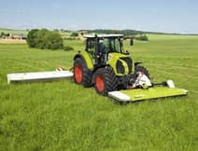
CLAAS Equipment
CLASS has entered a partnership
venture with 365FarmNet to facilitate
the service to farmers, in which they
can manage and control their agricultural
plotting via a computer or smartphone;
It collects important pieces of
information for further analysis. This
information may be used in field mapping and in various planning programs like fertilization and nutrient planning.

